Slide 1
Astronomy Club Xmas Quiz 2017
Questions and Answers

Slide 2
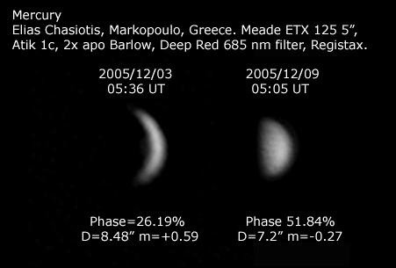
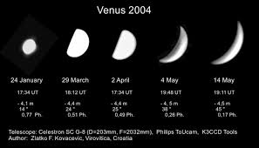
Q1: The only planet that shows phases apart from Mercury is?
[A]Earth
[B]Venus
[C] Jupiter
[D] Saturn
[E] The Moon

Slide 3
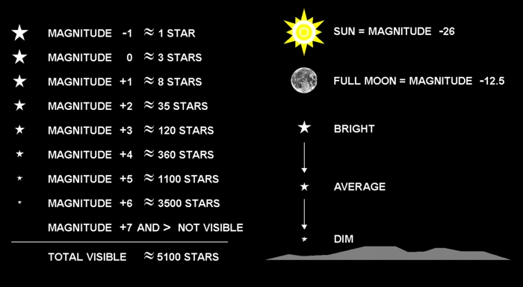
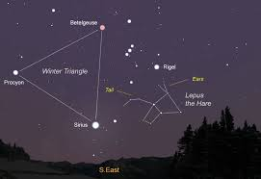
Q2: Which among the following is Brightest star?
[A]Sirius
[B]Alpha Centauri
[C] Proxima Centauri
[D] Polaris

Slide 4
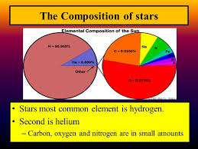
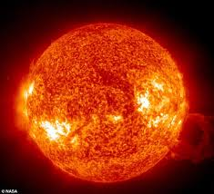
Q3: Which among the following two gases contribute to begin the formation of stars?
[A]Hydrogen & Nitrogen
[B]Nitrogen and Helium
[C]Helium & Hydrogen
[D]Hydrogen and Oxygen.

Slide 5
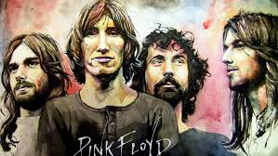
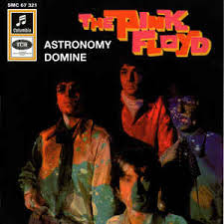
Q4: In Pink Floyds song, “"Astronomy Domine“, which three planets in the solar system are mentioned? One point for each correct guess!
Planets to pick from: Mercury, Venus, Earth, Mars, Jupiter, Saturn, Uranus, Neptune.
Special clue: Pluto is not mentioned!
Lime and limpid green, a second scene
A fight between the blue you once knew.
Floating down, the sound resounds
Around the icy waters underground.
Jupiter and Saturn, Oberon, Miranda and Titania.
Neptune, Titan, Stars can frighten.

Slide 6
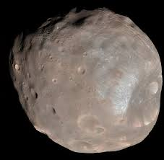
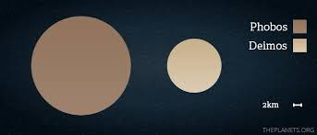
Q5: Which planet has a moon named Phobos that is predicted to possibly smash into the planet sometime within the next 30-50 million years?
Mars
Uranus
Jupiter
Venus

Slide 7
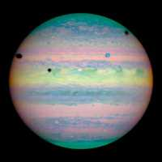
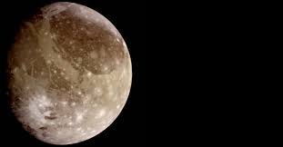
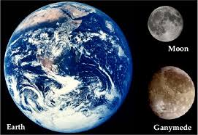
Q6: Named after a Trojan prince in Greek mythology, what is the largest moon in our solar system, which can be seen in this photo of Jupiter?
Dione
Mimas
Ganymede
Rhea

Slide 8
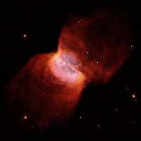
This beautiful image is of the Butterfly Nebula taken by the Hubble Space Telescope in the 1990s.
Q7: What kind of astronomical object is defined as an interstellar cloud of ionized gasses and dust?
Gas giant
Constellation
Nebula
Aurora

Slide 9
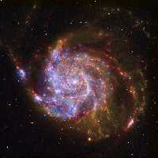
Q8: By looking at this image, can you tell me what general kind of galaxy the Milky Way is?
Elliptical galaxy
Lenticular galaxy
Irregular galaxy
Spiral galaxy

Slide 10
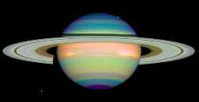
There are many gaps in the rings of Saturn. Of the options listed only the Maxwell Gap is one of them.
Q9: I am sure that my friend known as Agent 86 could answer just what is the name of the dark space seen here in the rings of Saturn?
The James Gap
The Bond Gap
The Madonna Gap
The Maxwell Gap

Slide 11
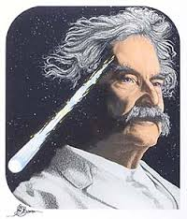
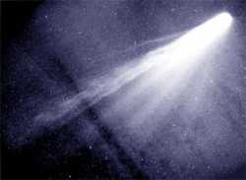
Q10: Author Mark Twain could tell you that this is an image of which celestial body that is seen on earth every 75 to 76 years?
Samuel's Comet
Langhorne's Comet
Clemens's Comet
Halley's Comet
For a bonus point, what is the connection between Twain and this comet?
On the date of the both the birth and the death of American author Mark Twain, Halley's Comet was overhead. English astronomer Edmond Halley (1656-1742) successfully predicted the return of this comet and it was named in his honor.

Slide 12
Question 11:
What do the letters ESA stand for?
European Space Agency

Slide 13
Question 12:
What do the letters ISS stand for?
International Space Station

Slide 14
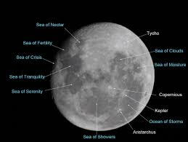
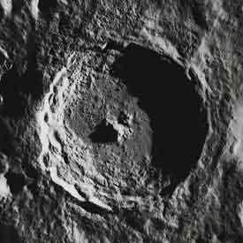
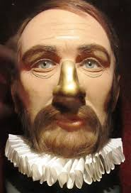
Q13: What is the name of the most prominent crater on the Moon?
Tycho (after Tycho Brahe)
Copernicus
Kepler

Slide 15
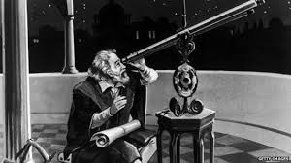
Q14: In 1609 Galileo discovered four moons orbiting Jupiter. Three of them are named "Io", "Ganymede" and "Callisto." What did he name the other one?
Vesta
Europa
Amalthea

Slide 16
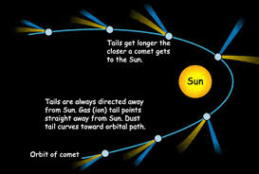
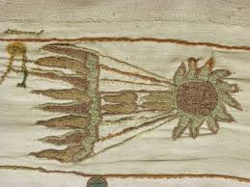
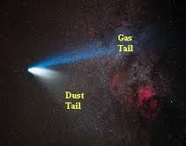
Q15: How many tails does a comet have as it approaches the Sun?
One
Two
Three

Slide 17
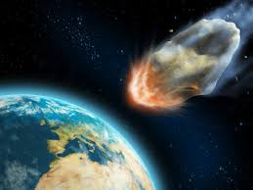
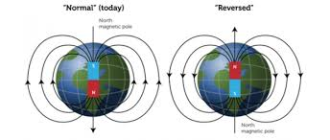
Q16: What did the Earth do in 1910 that caused unnecessary fear for many people around the world?
Nearly missed an asteroid.
Reversed its magnetic poles.
Passed through a comet tail.

Slide 18
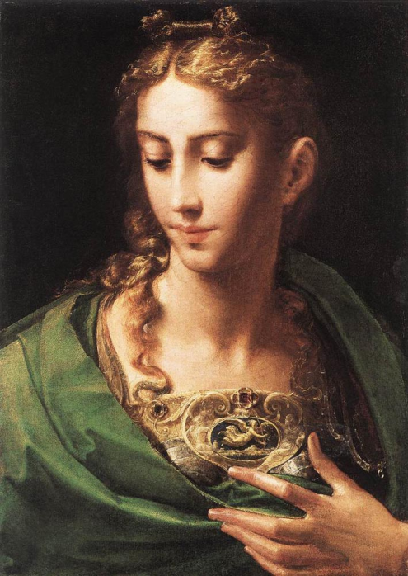
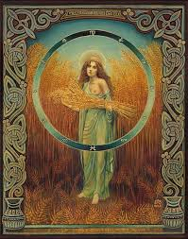
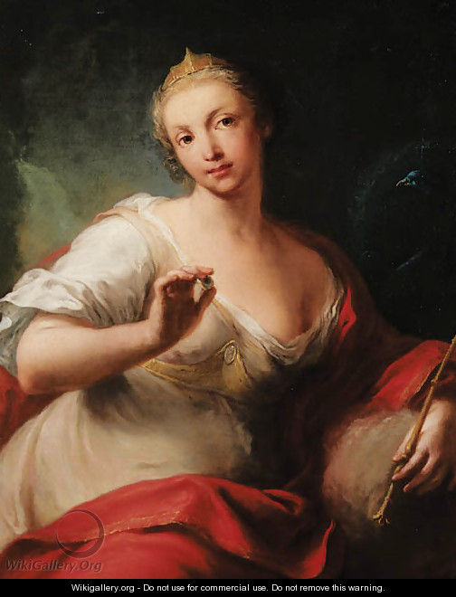
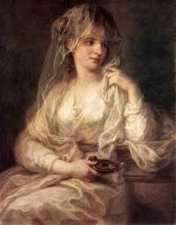
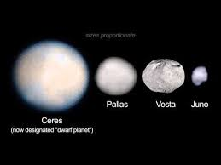
Q17: Ceres, Pallas, Juno, and Vesta are names for four of what type of objects?
Asteroids
Moons
Stars
Kuiper Belt Objects
They are also the names of four goddesses depicted in the paintings above.

Slide 19
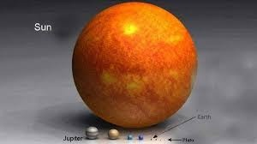
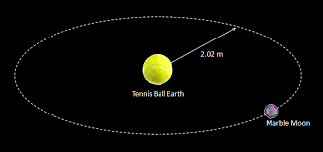
Q18: If the Earth were the size of a tennis ball, how big and how far away would the Sun be?
A basketball 12 miles away
24 feet across, 1/2 mile away
48 miles across, 126 miles away

Slide 20
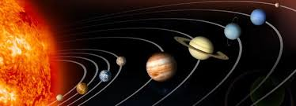
Q19: After the Sun and the planets, what is the largest body in the solar system?
Ganymede
Pluto
Earth's Moon

Slide 21
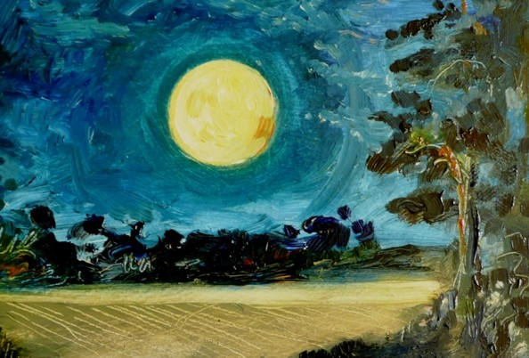
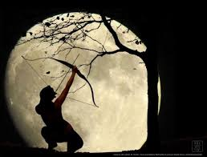
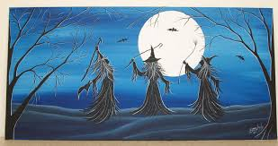
Q20: What is the name given by some to the full moon nearest the winter solstice?
Witch's Moon
Hunter's Moon
Harvest Moon

Slide 22
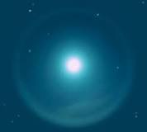
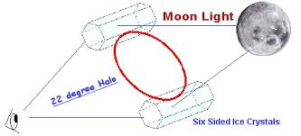
Q21: Sometimes there is a ring around the Moon. What causes this?
Gravitational lensing
Micrometeroidal particles
Atmospheric ice crystals

Slide 23
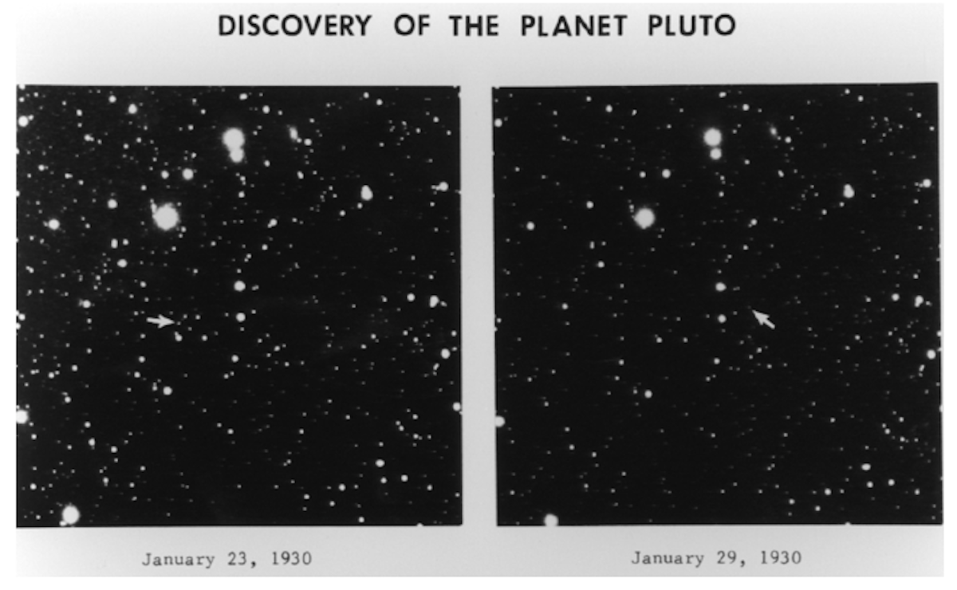
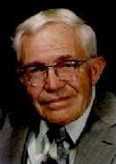
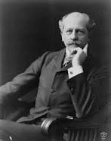
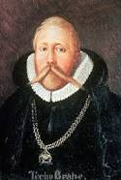
Q22: Who discovered Pluto?
Clyde Tombaugh 1930
Percival Lowell
Tycho Brahe

Slide 24
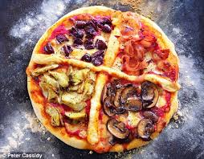
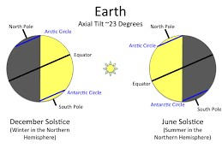
Q23: What is the primary
cause of the seasons?
Tilt of Earth's axis
Inclination of Earth's orbit
Changing distance to the Sun

Slide 25
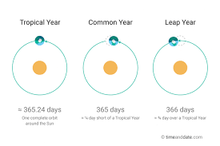
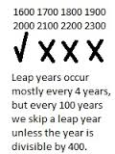
Q24: How many leap years are there in 400 years?
104
100
97
Years that are evenly divisible by 100 are not leap years, unless they are also evenly divisible by 400, in which case they are leap years. 400 years has 100 leap years for every four years, less 3 for each 100th apart from the 400th

Slide 26
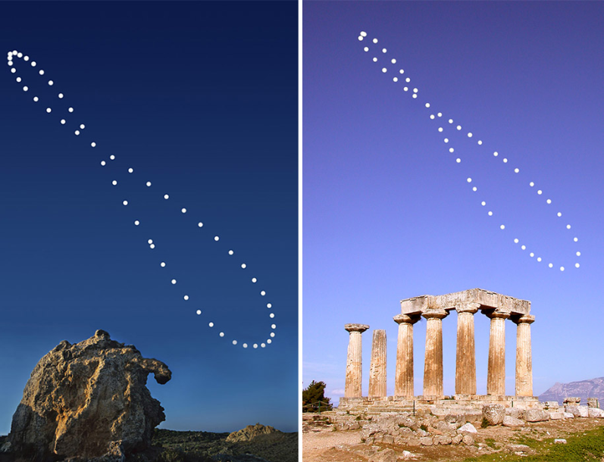
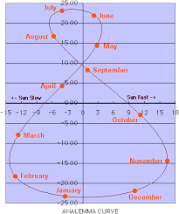
Q25: The precise position of the Sun at noon each day changes over a period of a year, describing a "figure 8" in the sky. What is this called?
The Analemma
Precession of the Equinox
Solar Constant
In astronomy, an analemma is a diagram showing the deviation of the Sun from its mean motion in the sky, as viewed from a fixed location on the Earth

Slide 27
Q25: What celestial objects are named after characters in Shakespeare plays?
Some near-Earth asteroids
Some moons of Uranus
Some craters on Mercury

Slide 28
Q27: What is the speed of light?
(in a vacuum)
6,800 miles per second
547,000 miles per hour
1,000,000 miles per hour
186,000 miles per second
(299,792.458 kilometres per second )

Slide 29
Q28: Which scientist discovered that the universe was expanding?
Edwin Hubble
Galileo
Stephen Hawking
Albert Einstein

Slide 30
Q29: What is the universe
mostly composed of?
Dark energy
Light
Visible matter
Dark matter
In physical cosmology and astronomy, dark energy is an unknown form of energy which is hypothesized to permeate all of space, tending to accelerate the expansion of the universe.

Slide 31
Q30: What types of stars are the hottest stars?
O
K
M
G

Slide 32
Q31: What is the estimated age of the universe?
2 billion years
500 million years
1 trillion years
13 billion years

Slide 33
Q32: Which nebula are "the pillars of creation" located?
Bug nebula
Eagle nebula
Horse head nebula
Crab nebula
Mutara Nebula

Slide 34
Q33: Which fictitious nebula featured in Star Trek II: The Wrath of Khan
Bug nebula
Eagle nebula
Horse head nebula
Crab nebula
Mutara Nebula

Slide 35
Q34: In which TV show would you be likely to meet a Vogon?
Buck Rogers in the 25th Century
The Hitchhiker’s Guide to the Galaxy
Lost in Space
Red Dwarf

Slide 36
Q35: One giant leap for bug-kind
Some organisms can survive in space without any kind of protective enclosure.
True
False
SCIENCE FACT.
In a European Space Agency experiment conducted in 2005, two species of lichen were carried aboard a Russian Soyuz rocket and exposed to the space environment for nearly 15 days. They were then resealed in a capsule and returned to Earth, where they were found in exactly the same shape as before the flight. The lichen survived exposure to the vacuum of space as well as the glaring ultraviolet radiation of the Sun.

Slide 37
Q36: Has E.T. already phoned home?
We now have evidence that some form of life exists beyond Earth, at least in primitive form.
True
False
SCIENCE FICTION.
While many scientists speculate that extraterrestrial life exists, so far there is no conclusive evidence to prove it. Future missions to Mars, the Jovian moon Europa and future space telescopes such as the Terrestrial Planet Finder will search for definitive answers to this ageless question.

Slide 38
Q37: May the force be with you
In the "Star Wars" films, the Imperial TIE Fighters are propelled by ion engines (TIE stands for Twin Ion Engine). While these spacecraft are fictional, real ion engines power some of today’s spacecraft.
True
False
SCIENCE FACT.
Ion propulsion has long been a staple of science fiction novels, but in recent years it has been successfully tested on a number of unmanned spacecraft, most notably NASAÕs Deep Space 1. Launched in 1998, Deep Space 1 rendezvoused with a distant asteroid and then with a comet, proving that ion propulsion could be used for interplanetary travel.
Pictured is NASA's 2.3 kW NSTAR ion thruster for the Deep Space 1 spacecraft during a hot fire test at the Jet Propulsion Laboratory

Slide 39
Q38: Good day, Sunshine
Tatooine, Luke Skywalker's home planet in the "Star Wars" films, has two Suns -- what astronomers would call a binary star system. Scientists have discovered recently that planets really can form within such systems.
True
False
SCIENCE FACT.
Double-stars, or binary systems, are common in our Milky Way galaxy. Among the more than 100 new planets discovered in recent years, some have been found in binary systems, including16 Cygni B and 55 Cancri A. (But so far, no one has found a habitable planet like Luke Skywalker's Tatooine.)

Slide 40
Q39: What is generally the best time of year to look for the Northern Lights (Aurora Borealis?)
No time of the year is more favorable for aurora viewing than any other.
Around the time of the equinoxes - Nobody is quite sure why.
Around the time of the winter solstice
April - July

Slide 41
Q40: How hot is a lightning bolt compared to the Sun's "surface?" (photosphere)
a. a lightning bolt is 1% as hot
b. a lightning bolt is generally 7% as hot
c. most lightning bolts are 11 - 19% as hot
d. none of the above –
Lightning bolts are five times hotter than the sun's surface!

Slide 42
Q41: Christmas was originally celebrated at various times throughout the year. When was December 25th established as the official birthday of Jesus Christ? (Note: all the times listed below are AD, of course.)
4th century
6th century
11th century
13th century
Roman Emperor Constantine, the first Christian emperor, first celebrated Christmas on December 25th, a date which had been celebrated as "The Birthday of the Unconquered Sun." Later that century, Pope Julius I established December 25th as Christ's birthday.

Slide 43
Q42: "La Befana" is the female Santa Claus counterpart in which country?
Italy
Spain
c. Brazil
d. Costa Rica
In Italian folklore, Befana is an old woman who delivers gifts to children throughout Italy on Epiphany Eve (the night of January 5) in a similar way to St Nicholas

Slide 44
Q43: Hamal, Sheratan, Mesarthim
are the names of stars within
which constellation?
a. Aries the Ram
b. Scorpius the Scorpion
c. Hercules

Slide 45
Q44: "Corvus" is the name of the constellation depicting a
Whale
Crow
Dog
Sextant
La Corbière (Jèrriais: La Corbiéthe) is the extreme south-western point of Jersey in St. Brelade. The name means "a place where crows gather", deriving from the word corbîn meaning crow. However, seagulls have long since displaced the crows from their coastal nesting sites.

Slide 46
Q45: A librarian at Alexandria
provided the first estimate of
Earth's circumference. He was:
Ptolemy
Hipparchus
c. Eratosthenes
Sappho
Eratosthenes divided 360° by 7.2° and got 50, which told him that the distance between Alexandria and Syene (500 miles) was 1/50 of the total distance around the Earth. So he multiplied 500 by 50 to arrive at his estimate of the Earth's circumference: 25,000 miles.

Slide 47
Q46: Science Fiction films: which one does the picture above come from?
Solaris
A Boy and His Dog
THX 1138
2001: A Space Odyssey

Slide 48
Q47: Science Fiction films: which one does the picture above come from?
Star Trek IV: The Voyage Home
Cocoon
The Fifth Element
Star Wars V: The Empire Strikes Back

Slide 49
Q48: Science Fiction films: which one does the picture above come from?
Planet of the Apes
Moon
The Man Who Fell to Earth
Time After Time

Slide 50
Question 49:
Fly me to the moon
Let me play among the stars
Let me see what spring is like on X and Y
[Let me see what spring is like on Jupiter and Mars]
What are the missing planets in Frank Sinatra’s song “Fly Me To The Moon Lyrics”?
Mars has seasons. Jupiter, like Venus, has an axial tilt of only 3 degrees, so there is literally no difference between the seasons.

